Slide 1

Understanding Behaviour Through Affect Script and Compass of Shame Dr Scott I-Patrick Senior Educational Psychologist

Slide 2

Session Overview & Objective
Session Overview
The session will lay the groundwork for understanding these pivotal concepts of Affect Script and Compass of Shame, then move beyond theory to explore their practical applications in classrooms.
Objective
The aim is to not only build a foundational understanding of these theories but also to equip ourselves with effective strategies for addressing the emotional and behavioural needs of our students.

Slide 3

Introduction to Key Concepts
An exploration of the core elements of Affect Script Theory and Nathanson's Compass of Shame.
Linking Theory to Practice: Focus will be on practical application

Slide 4

Practical Outcomes
Our journey today will take us from theoretical understanding to real-life applications. By the end of this session, The aim is to provide practical tools and strategies that enhance our capacity to support our students' emotional and educational needs empathetically and effectively.

Slide 5

From Affect to Affect Scripts
What is Affect?
The Basics of Emotional Responses

Slide 6

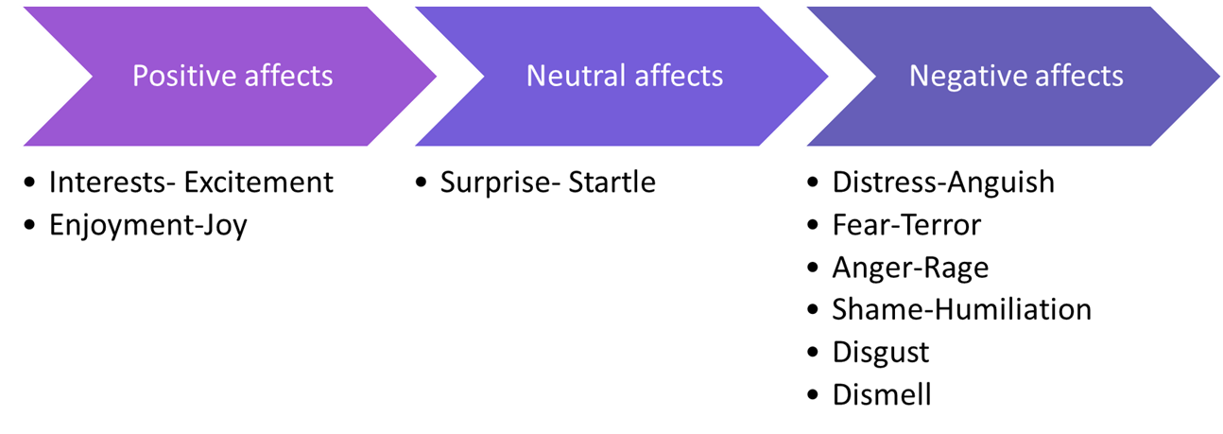
cOmpass of Shame scripts
Notes:
I

Slide 7
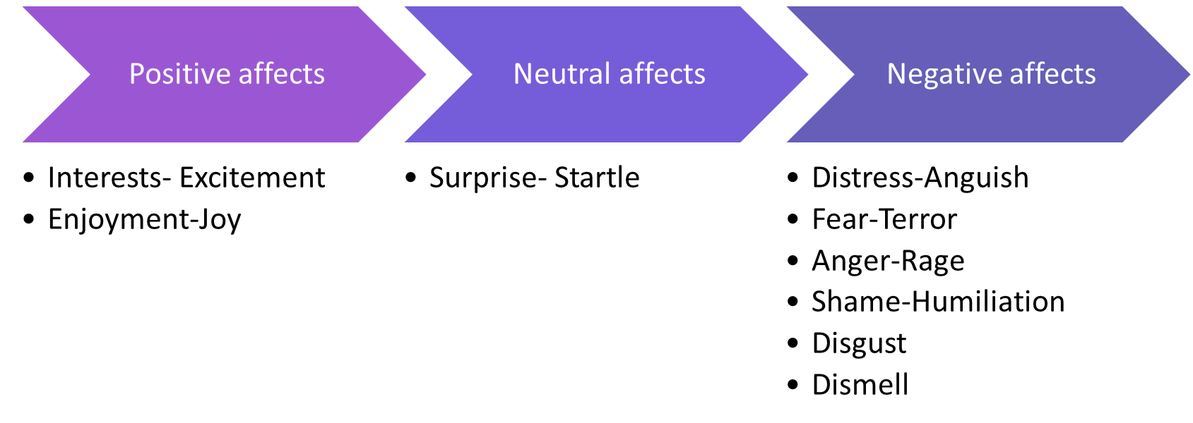
Notes:
Examples of what might trigger these affects include:
Pupil’s senses picking up something to big, too loud, or too fast, and/or feeling threatened (fear-terror).
Response triggered when too much has been happening for too long, or when overwhelmed (distress-anguish).
When that too much finally stops happening or a reward is received (enjoyment-joy).
When senses encounter a novel stimulus that is just right or discovering something new (interest-excitement).
Experiencing an unexpected event (surprise-startle).
Being treated unfairly (anger-rage).
Encountering something unpleasant (disgust).
Feeling exposed (shame-humiliation).
Select one or two examples- don’t go through them all
A pupil's biography can intensify their reactions to situations. This is particularly true when pupils are confronted with challenges that have persisted for a long time.
Pupils may use presenting behaviours as a way to maximise positive affects and avoid negative affects triggered by persistent challenges. For example, a pupil who has experienced neglect may seek attention through disruptive behaviour, as a way of compensating for the lack of attention they received at home.
By understanding the role of biography, we can begin to recognise the underlying needs of pupils and respond to them in a more targeted way.
Most of the experiences of interest and joy that get impeded have to do with interpersonal engagement with others. So, think of shame as an interpersonal/interactional affect.
Once positive affect is impeded, the affect shame focuses attention on the impediment that triggered the negative affect.
Now, the thing is what we see in the moment of shame is something in us that isn’t perfect – scripted emotions/biography.
Pupil’s draw on scripts built up over time to help minimise the destructive impact of negative affects…

Slide 8

Examples of Affects in Action
Consider a student, Alex, who feels a rush of joy when praised for good work. Alternatively, imagine Mia feeling a wave of disappointment when she struggles with a math problem. These are instances of affects in action, immediate emotional responses to specific situations.

Slide 9
The Journey from Affect to Affect Scripts
How do we move from these individual affects to affect scripts?
Affect scripts are formed when these emotional responses become patterned and internalised over time.
They evolve from our repeated experiences with similar stimuli or situations.
Notes:
Now,…

Slide 10
Role of Repeated Affects in Script Formation
If Alex consistently receives positive reinforcement, he may develop a script associating effort with positive outcomes. This script becomes a lens through which Alex views learning experiences, influencing his future behaviours and emotional responses.
Notes:
For instance, …

Slide 11

Case study 1:Positive Script Formation
Background: Consider Sarah, a student who consistently receives praise and encouragement for her efforts, regardless of the outcome. Her teachers focus on the process of learning rather than just the results.
Script Development: Over time, Sarah develops a positive script. She associates effort with positive emotions, such as pride and satisfaction, fostering a growth mindset. She is not afraid to make mistakes, viewing them as part of the learning process.

Slide 12

Behavioural Outcome
In class, Sarah actively participates, takes on new challenges, and demonstrates resilience in the face of difficulties. Her positive script guides her to approach learning with enthusiasm and a belief in her own capabilities.

Slide 13
Case Study 2 - Negative Script Formation
Background: Now, let's look at Tom, who often receives criticism for his mistakes. He rarely hears positive feedback about his efforts, leading him to associate schoolwork with negative emotions.
Script Development: Tom develops a negative script. He starts believing that effort leads to disappointment and criticism. This script ingrains in him a sense of fear and avoidance towards learning and trying new tasks.

Slide 14
Behavioural Outcome
In the classroom, Tom is reluctant to participate, often appears disengaged, and may even exhibit disruptive behaviour as a defense mechanism. His negative script leads to a lack of self-confidence and a fear of failure.

Slide 15
Reflective Activity
I invite you to reflect on your students. Think about their behaviours and try to identify potential scripts they might be following. Consider their reactions to success, failure, and feedback. What emotional patterns can you discern?

Slide 16

Strategies: Identifying and Influencing Scripts
Consistent Positive Reinforcement: Regularly acknowledge and celebrate students' efforts, not just their achievements. This approach can help in developing positive scripts, reinforcing the idea that effort is valuable and appreciated.
Creating a Safe Emotional Space: Foster an environment where students feel safe to express their emotions. Encourage them to share their feelings and experiences, helping them to understand and navigate their emotional scripts.
Incorporating Mindfulness Practices: Introduce mindfulness activities, such as guided breathing or reflection exercises. These can help students become more aware of their emotional responses and learn to manage them effectively, thereby influencing the formation of more adaptive scripts.

Slide 17
Balancing Affects: The Role of the Central Executive
The Central Executive's Role:
Our central executive acts as an internal moderator, guiding us to maximize positive emotions and minimize negative ones. It’s vital in our pursuit of a balanced emotional state.
Our Innate Guide for Emotional Balance
Maximizing Positive Affect: Cultivating Joyful Experiences
Minimizing Negative Affect: Navigating Challenges
Minimizing Inhibition of Affect: Encouraging Emotional Expression
Achieving a Balanced SEMH: Integrating 1 to 3 in Education

Slide 18
Balancing Affects: The Role of the Central Executive
Real-Life Examples
In school settings, CYP often rely on adults to understand and support them. For example, a child in care might experience instability and emotional challenges, needing an environment that maximizes positive affect through supportive interactions.
Alternatively, a child experiencing bereavement or domestic violence needs a space where their negative affect is not suppressed but acknowledged and addressed, fulfilling the central executive’s role of minimizing the inhibition of affect.

Slide 19
Educational Implications
When educators fail to provide such support, it leads to an imbalance, often resulting in masking or adverse outcomes.
This highlights the importance of our role in creating an environment that adheres to these principles of emotional regulation.

Slide 20

Strategies for Educators
We can foster a balanced SEMH by:
Encouraging the expression of all emotions
Providing support for negative experiences and celebrating positive moments.
This approach not only adheres to our innate emotional needs but also creates a nurturing educational environment.

Slide 21

Harnessing Joy and Interest in Learning
Igniting Learning through Intrinsic Motivation
The Essence of Intrinsic Motivation: Joy and Interest as Catalysts
The Drawbacks of Extrinsic Motivation: Understanding Limits
Customizing Learning: Tuning into Individual Interests

Slide 22

Practical Application
To implement this, we need to become adept at recognising each child's unique interests and motivators.
This requires keen observation, open communication, and a flexible teaching approach.
It is about creating a learning environment that kindles curiosity and passion in each student, making their educational journey as unique as they are.

Slide 23
Navigating the Complexities of Shame
Decoding Nathanson's Compass of Shame
Understanding the Four Responses to Shame
The Role of Shame in Learning and Relationships
Recognising and Addressing Shame Responses in Students

Slide 24
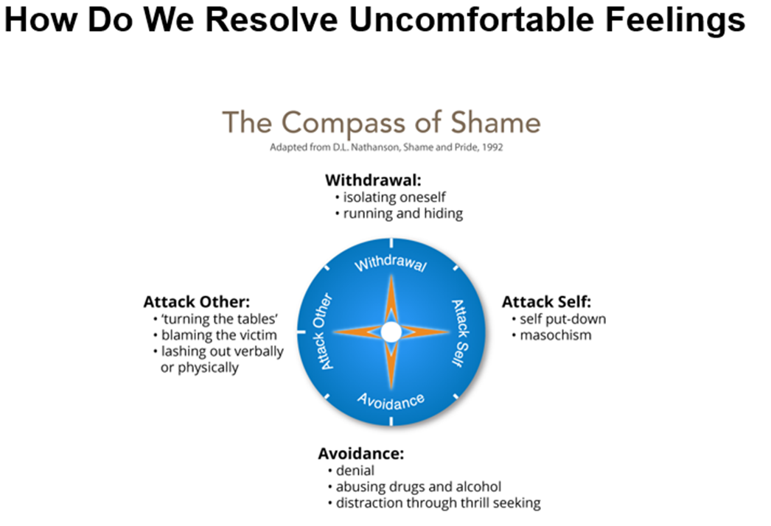
cOmpass of Shame scripts
Notes:
I

Slide 25
Real-Life Examples
Consider Farouk, a student who, overwhelmed by anger and shame, resorted to aggression, illustrating the 'Attack Others' quadrant​​.
Contrast this with Caslin, who felt misunderstood and labelled, possibly leading to 'Withdrawal' or 'Attack Self' responses​​.

Slide 26

Impact of Shame in Educational Context
Shame can significantly impact learning and relationships in school
Strategies for Educators
It's crucial to create a learning environment that minimizes shame and promotes emotional safety. This involves:
understanding each student's emotional landscape
offering support without judgment
fostering a culture where mistakes are seen as learning opportunities rather than sources of shame.

Slide 27

Fostering Trust and Safety: Key to Effective Support
Cultivating Trust and Safety in the Learning Environment
Essential Role of Trust in Emotional Regulation and Learning
Creating a Safe Space for Handling Affects and Shame
Enhancing Learning through a Trust-Based Approach

Slide 28
Embracing Emotional Intelligence in Education
Integrating Emotional Understanding for Holistic Education
Key Insights from Today's Session
The Role of Emotional Intelligence in Student Developme
Our Commitment as Educators

Slide 29
Closing Thought
Let's carry forward the insights from today, integrating them into our teaching practices. Our goal is to cultivate a learning space where every student feels understood, valued, and supported, paving the way for their all-around success.

Slide 30
REFERENCES
George, G. (2014). Affect and Emotion in a Restorative School. In V. Kelly & M. Thorsborne (Eds.), The Psychology of Emotions in Restorative Practice (First, pp. 200–231). Jessica Kingsley.
Dweck, CS, 2012, Mindset, Constable & Robinson, London, 2012
Kelly, V. C. (2014). Caring, Restorative Practice and the Biology of Emotion. In V. Kelly & M. Thorsborne (Eds.), The Psychology of Emotions in Restorative Practice (First, pp. 200–231). Jessica Kingsley.
Nathanson, D.l. (1992) Shame and Pide: Affect, Sex, and the Birth of the self. New York, NY: W.W. Norton.
Tomkins. S. (2008) Affect Imagery Consciousness: the Complete Edition. New york, NY : Springer.

Slide 31
Handout: Practical Strategies for Emotional Support in Classrooms
Recognising and Addressing Affect Scripts
Observe emotional responses and encourage students to articulate their feelings
Use consistent positive reinforcement to influence and reshape negative scripts
Managing Shame Responses
Foster a non-judgmental and supportive environment for sharing emotions
Teach and practice coping skills like mindfulness and perspective-taking
Building Trust and Safety
Implement clear and consistent classroom rules
Actively listen and show genuine interest in students' lives and experiences
Celebrate diversity and encourage inclusivity

Slide 32

Handout: Practical Strategies for Emotional Support in Classrooms
Example for Affect Scripts
"Student A frequently exhibits frustration in math class. By discussing these feelings openly, the teacher realizes that Student A has developed a negative script associating math with failure. The teacher begins to acknowledge Student A's effort and small successes, gradually helping to shift this script."
Example for Shame Responses
"Student B often reacts defensively to feedback. Recognizing this as a potential 'Attack Others' shame response, the teacher creates opportunities for Student B to express feelings in a safe space and teaches strategies for constructive feedback acceptance."
Regular Check-ins: Schedule time for individual or group discussions about emotions and experiences

Slide 33

Handout: Practical Strategies for Emotional Support in Classrooms
Responsive Teaching: Adapt teaching methods to accommodate diverse emotional needs
Positive Reinforcement: Focus on effort and improvement, rather than just outcomes
Mindfulness Practices: Incorporate simple mindfulness exercises at the beginning or end of classes

